Slide 1
Corning Renewable Energy

Slide 2
Information security
This presentation contains Corning information and is intended solely for those with a need to know. It may not be distributed, in whole or part, in any form by any means, or by any person or organization without authorization from Corning Incorporated.
Notes:
This deck is for internal use only.

Slide 3
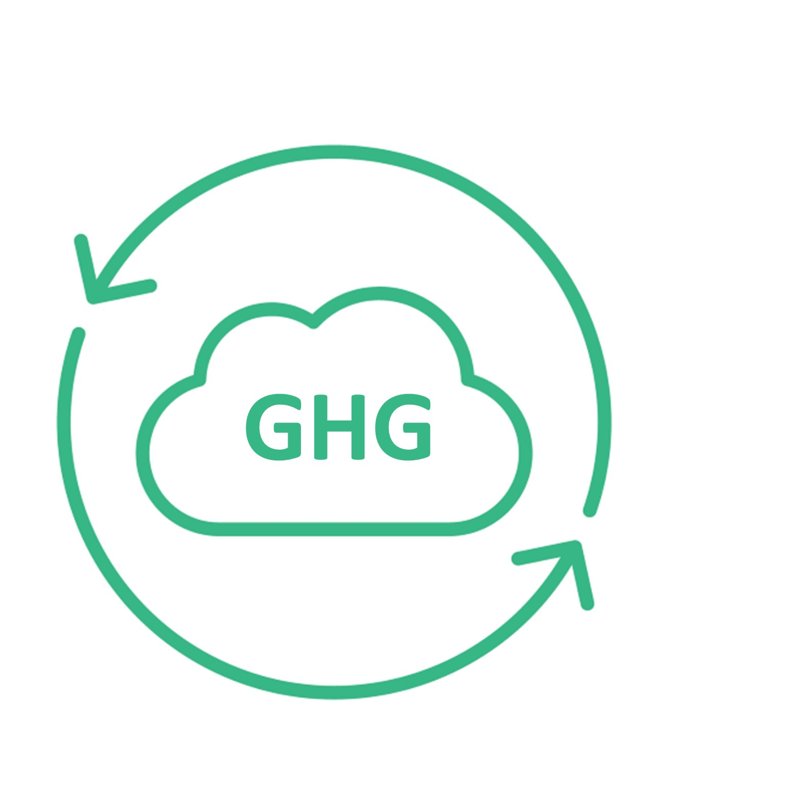
Renewable Energy
Speakers
Madeline Vincitore
Project Director WSP,
Sustainability Energy and Climate Change
Bridget Venne
AVP, WSP,
Sustainability Energy and Climate Change
Adeola Adeusi
Project Manager,
Global Supply Management Corning Inc.

Slide 4
Planned Training Webinars
Training Topic | Webinar Date
Scopes 1&2 Accounting Training | May 4th
Scope 3 Accounting Training | May 11th
Setting a Science Based Target Training | May 18th
Renewable Energy Target and Procurement Training | May 25th
Product Carbon Footprint Training | June 1st
Suppliers that are requested to attend specific trainings based on maturity level will be notified by email. All trainings are optional for all suppliers.

Slide 5
Agenda
Renewable Energy
Corning's Goals and Progress
New Corning Supplier Requirements
Renewable Energy Overview
Renewable Energy Target Options
Renewable Energy Procurement and Roadmap Development
Best Practices
Resources

Slide 6
Webinar Objectives
Understand Corning’s updated supplier expectations
Understand what renewable energy is and why it is important
Understand how to develop a renewable energy target and roadmap
Understand renewable energy procurement options

Slide 7
Corning Scope 3 Emission Program
Adeola Adeusi

Slide 8
Our Approach
To Sustainability
At Corning, we take a long-term approach to sustainability, as we address key challenges of the moment and evolve to meet the needs of the future.
We think about our contributions in two categories. One is our footprint – how our actions directly affect others in areas such as gender pay equity and carbon emissions from our operations. The other is our handprint – what we enable others to do through our products and services, such as helping to deliver over 8 billion COVID-19 vaccine doses to date through our glass vials.
We prioritize areas where we have distinctive capabilities to create value for our shareholders and meaningful progress for society. We also emphasize areas where our stakeholders are looking for us to set an example – areas such as supporting human rights in our supply chain, advancing gender equity, and acting with integrity in all we do. Investing in these areas also makes us more resilient and supports our ability to do what we do best – innovate.
“Quite simply, we’ve succeeded over the long term by always working to become better versions of ourselves. We never lose sight of our purpose, our Values, and the importance of engaging with – and delivering for – key stakeholders. And that’s “our why” – we always seek to advance and apply our leadership capabilities to make a positive difference in the world.”
Wendell P. Weeks
Chairman and Chief Executive Officer

Slide 9
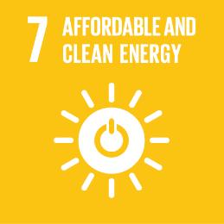
2023 Corning Sustainability Goals
Reduce our absolute Scope 1 and 2 greenhouse gas (GHG) emissions 30% by 2028 from a 2021 base year
Reduce our absolute Scope 3 GHG emissions, covering purchased goods and services, capital goods, fuel- and energy-related activities, and upstream transportation and distribution 17.5% by 2028 from a 2021 base year
Increase our use of renewable energy by 400% by 2030 from a 2018 baseline
By the end of 2023, assess Corning’s exposure to water stress
By the end of 2024, Corning will be generating monthly, accurate, and comprehensive water use data for our top 10 water-use facilities
By the end of 2028, Corning will increase its waste diversion rate to greater than 80% globally
New!
By the end of 2023, Corning will be generating monthly, accurate, and comprehensive landfill waste and diverted waste data for our top 10 waste-generating sites
Certify 100% of our high-risk suppliers as socially responsible by 2025
Reduce our total recordable case incident rate (TRIR) within the portion of our operations that disproportionately contribute to our overall recordable injury and illness rate by at least 10%
Encourage increased volunteerism efforts year over year by supporting, rewarding, and recognizing employees’ efforts in the community
Achieve understanding of the Corning Code of Conduct, including how to report allegations of ethical or legal misconduct, among 100% of employees
New!
New!
New!
New!
Notes:
We have set goals within these focus areas and we are working diligently to achieve them. These goals were developed to support the united nations sustainable development goals aligning Corning’s efforts with global action on sustainability.
Didi will talk about our greenhouse gas reduction goals. We also introduced new water, waste and safety goals.
One that is very relevant to this group is our waste goals!
The following goals were graduated:
Maintain a diverse Board of Directors Corporate Governance and Risk Management
Conduct an annual review of the Sustainability Program by the Board of Directors Corporate Responsibility and Sustainability Committee Corporate Governance and Risk Management
Address environmental, social and governance issues in our Enterprise Risk Management Process Corporate Governance and Risk Management
Issue a sustainability report in 2021 and every year thereafter Transparency and Reporting
Continue advocacy for environmental and social issues Environmental and Social Advocacy SDG 12

Slide 10
Greenhouse Gas (GHG) Emissions Reduction Goals
In 2022, Corning submitted targets for validation to the Science Based Targets initiative (SBTi), underscoring our commitment to set near-term company-wide emission reductions in line with Climate science, and aligning with the goals of the Paris Agreement.

Slide 11
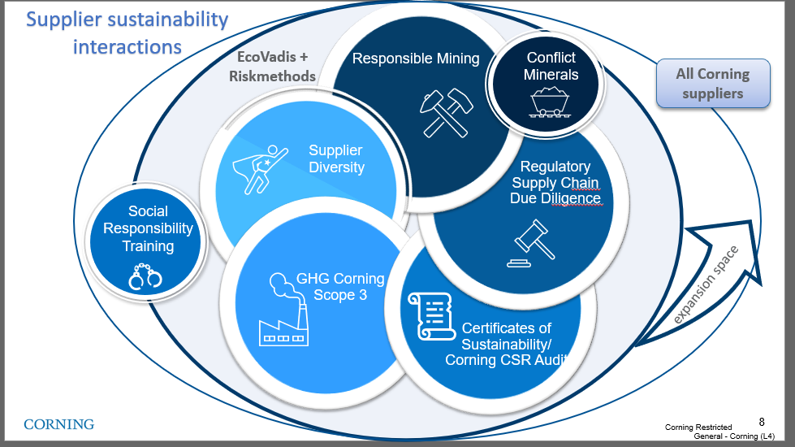
Climate Change is part of GSM's sustainability strategy
Our management of
Sustainable Supply Chain
Working with our suppliers globally, with a focus on Corporate Social Responsibility (CSR) and Climate Change Issues reduces our supply disruption risk and exposure to regulatory and reputational risk.
Our aim is to establish standardized, verified information-based management process contributing to Corning's long-term commitment on sustainable supply.
Supply Chain Sustainability Strategy
Scope 3 program
Last update Jan 2023
Notes:
CO₂ – Carbon dioxide
CH₄ – Methane
N₂O – Nitrous oxide (laughing gas)
HFC_{s} – Hydrofluorocarbons (refrigeration units, fire extinguishers, aerosols….)
PFC_{s} – Perfluorochemicals (heat, oil, water, etc., resistant coatings – think cookware, carpet stain prevention for regular people lives) mess up the endocrine activity, reduce immune function etc..
SF₆ – Sulfur hexafluoride – circuit breakers, arc suppressant , electrical insulator, semiconductor manufacturing, and the production of magnesium. One of the more potent GHG’s – it only takes a small amount to do significant damage. Used in the manufacturing as well as maintenance of grid equipment. One mitigation tactic is to regularly check equipment quality for leaks , training on employees how to maintain and service WHILE new options are being discovered.

Slide 12
2023 supplier engagement goals defined and set for deployment
Program
Deployment
Active Engagement
Emission Reduction Plan
Communicate supplier
engagement program to the suppliers that contribute 80% of Corning/Hemlock scope 3 emissions.
(PG&S, Capital Goods, Transportation)
Develop and implement emission reduction plans with supplier classified as engaged leaders in the scope emissions program
Actively engage and train the suppliers that contribute 60% of emissions in PG&S,CAP category and 80% in the Transportation
Corning approved channel
CDP supply chain program

Slide 13
2023 Supplier Activities for Scope 3 Emission
1
1
Register/ Sign up for CDP
If you company did not disclosure through CDP in 2022, please register your account.
2
Attend Trainings
2
GHG emission topics hosted by Corning/WSP
3
Calculate Emission data
3
Disclose scope 1, 2 and 3 greenhouse gas (GHG) emissions data. Provide independent or third-party assurance of disclosed emissions
4
Submit data and Allocate emission
4
Submit data through CDP. Deadline July 26th
5
Reduce Emissions
Adopt a science-based (SBTi-approved) emissions reduction target
Set a renewable energy target and water management goal
5

Slide 14
Partnership is Critical
Collaboration with suppliers will be key to enabling Corning to achieve our Scope 3 emissions reduction goal.
Working with Suppliers to Reduce Upstream Emissions
Together with our partners, Corning will continue to reduce global GHG emissions aligned with our commitment to climate action.
Corning will be rolling out our formal supplier engagement program in 2023 to reduce upstream emissions from suppliers systematically
Corning’s new product innovations are increasingly focused on reducing embodied carbon in our products and our customers’ products and operations.
Integrating Sustainability into Our Innovation Process
Corning has begun to use life cycle assessments performed by third parties to provide industry-recognized calculations of embodied carbon and we will request additional LCA information from suppliers through our supplier engagement program.
We are also developing GHG-impact estimates to be used in the early-stage design of products.

Slide 15
Corning Scope 3 Supplier Expectations
Suppliers engaged starting in 2023 are expected to adhere to these requirements by 2026:
Disclose scope 1, 2 and 3 greenhouse gas (GHG) emissions data through CDP Supply Chain
Provide independent or third-party assurance of disclosed emissions
Adopt a science-based (SBTi-approved) emissions reduction target
Set a renewable energy target
Respond to CDP Water Questionnaire
Set a water management goal

Slide 16
Renewable Energy Overview

Slide 17
Making Renewable Energy a Priority
Renewable Energy Overview
Renewable energy is a primary driver of emissions globally, and is a key contributor to Corning’s GHG emissions in their own operations, and their value chain
Corning is one of the largest users of solar energy in the United States and has committed to a four-fold increase in our renewable electricity use (2018 baseline) and is on a path to 100% renewables in the next few years in the United States, Canada, and Europe.
Corning's energy management has been recognized by the U.S. Environmental Protection Agency ENERGY STAR program for eight consecutive years.
Corning continues to optimize processes to reduce energy use through incentive programs to identify efficiency opportunities and sharing best practices about energy-saving opportunities globally.
The Corning plant in Vineland, New Jersey, has a rooftop solar array covering about 11 acres over five buildings.
Notes:
Procuring and developing renewable energy will be a component of corning’s SBTi target achievement

Slide 18
Renewable Energy Overview
Conventional Power
Renewable Energy
Green Power
Coal
Nuclear
Large Hydropower
Wind
Solar
Biomass
Oil
Natural Gas
Municipal Solid Waste
Geothermal
Biogas
Low-impact Hydropower
Most Beneficial
Least Beneficial
More Beneficial
Renewable energy is any form of energy from solar, geophysical, or biological sources that is replenished by natural processes at a rate that equals or exceeds its rate of use.
Notes:
When we speak about renewable energy, we mean any form of energy that is replenished by natural processes at a rate that equals or exceeds its rate of use.
Green power has less negative environmental impacts and is most beneficial to the environment.
Green power refers specifically to electricity supplied from a subset of renewable resources that provide the highest environmental benefit.
What is Green Power? The term green power can be used in several different ways. In this guide, Green Power is also defined as renewable electricity that goes above and beyond what is otherwise required by mandate or requirement – green power is also voluntary or surplus to regulation. Renewable energy is supplied by natural resources that replenish themselves over short periods of time without being depleted. Green power is a subset of renewable energy and represents those renewable energy resources that provide the highest environmental benefit, such as:  Solar  Wind  Geothermal (the earth’s heat)  Biogas  Biomass (some forms of plant and waste material)  Low-impact hydroelectric resources Green power generally does not include some resources that are often considered as renewable energy including large hydropower and municipal solid waste.

Slide 19
Benefits of Renewable Energy
Renewable Energy Overview
Reduce organizational carbon footprint
Achieve GHG reduction and Net Zero goals
Directly impact Scope 2 market-based emissions
When paired with energy efficiency efforts, can also reduce costs
Reduce air pollution and environmental impacts on water
Improve relationships with your local communities
Green power generates fewer emissions than conventional power, helping to protect human health and the environment
Many green power technologies do not consume water and have a negligible impact on local aquatic ecosystems
Manage electricity prices and supply disruptions
Due to technological innovations, the cost of green power projects has significantly declined due to increased demand and production, resulting in continued cost reductions.
Organizations that procure green power through long term contracts can mitigate purchased electricity prices overtime by locking in fixed costs and associated environmental attributes
Increase reliability and security of supply for specific facilities or processes with on site renewables. Mitigate the impact of supply uptions due to logistics challenges or natural disasters. When paired with storage solutions, renewables can improve supply reliability and resiliency in times of local power outages.
Notes:
Mitigate purchased electricity price increases
Hedge against electricity price volatility (if exposed to the wholesale market)
Establish predictable electricity cost budgets through 2030
Increase reliability and security of supply for specific facilities or processes
Build brand recognition for specific products that can be marketed as “Made with Renewable Energy.”
Increase shareholder satisfaction by reducing emission risk or liability
Take visible actions in the community to demonstrate civic leadership and environmental commitment.
Qualify as part of a green supply chain serving a larger business

Slide 20
Target Setting

Slide 21
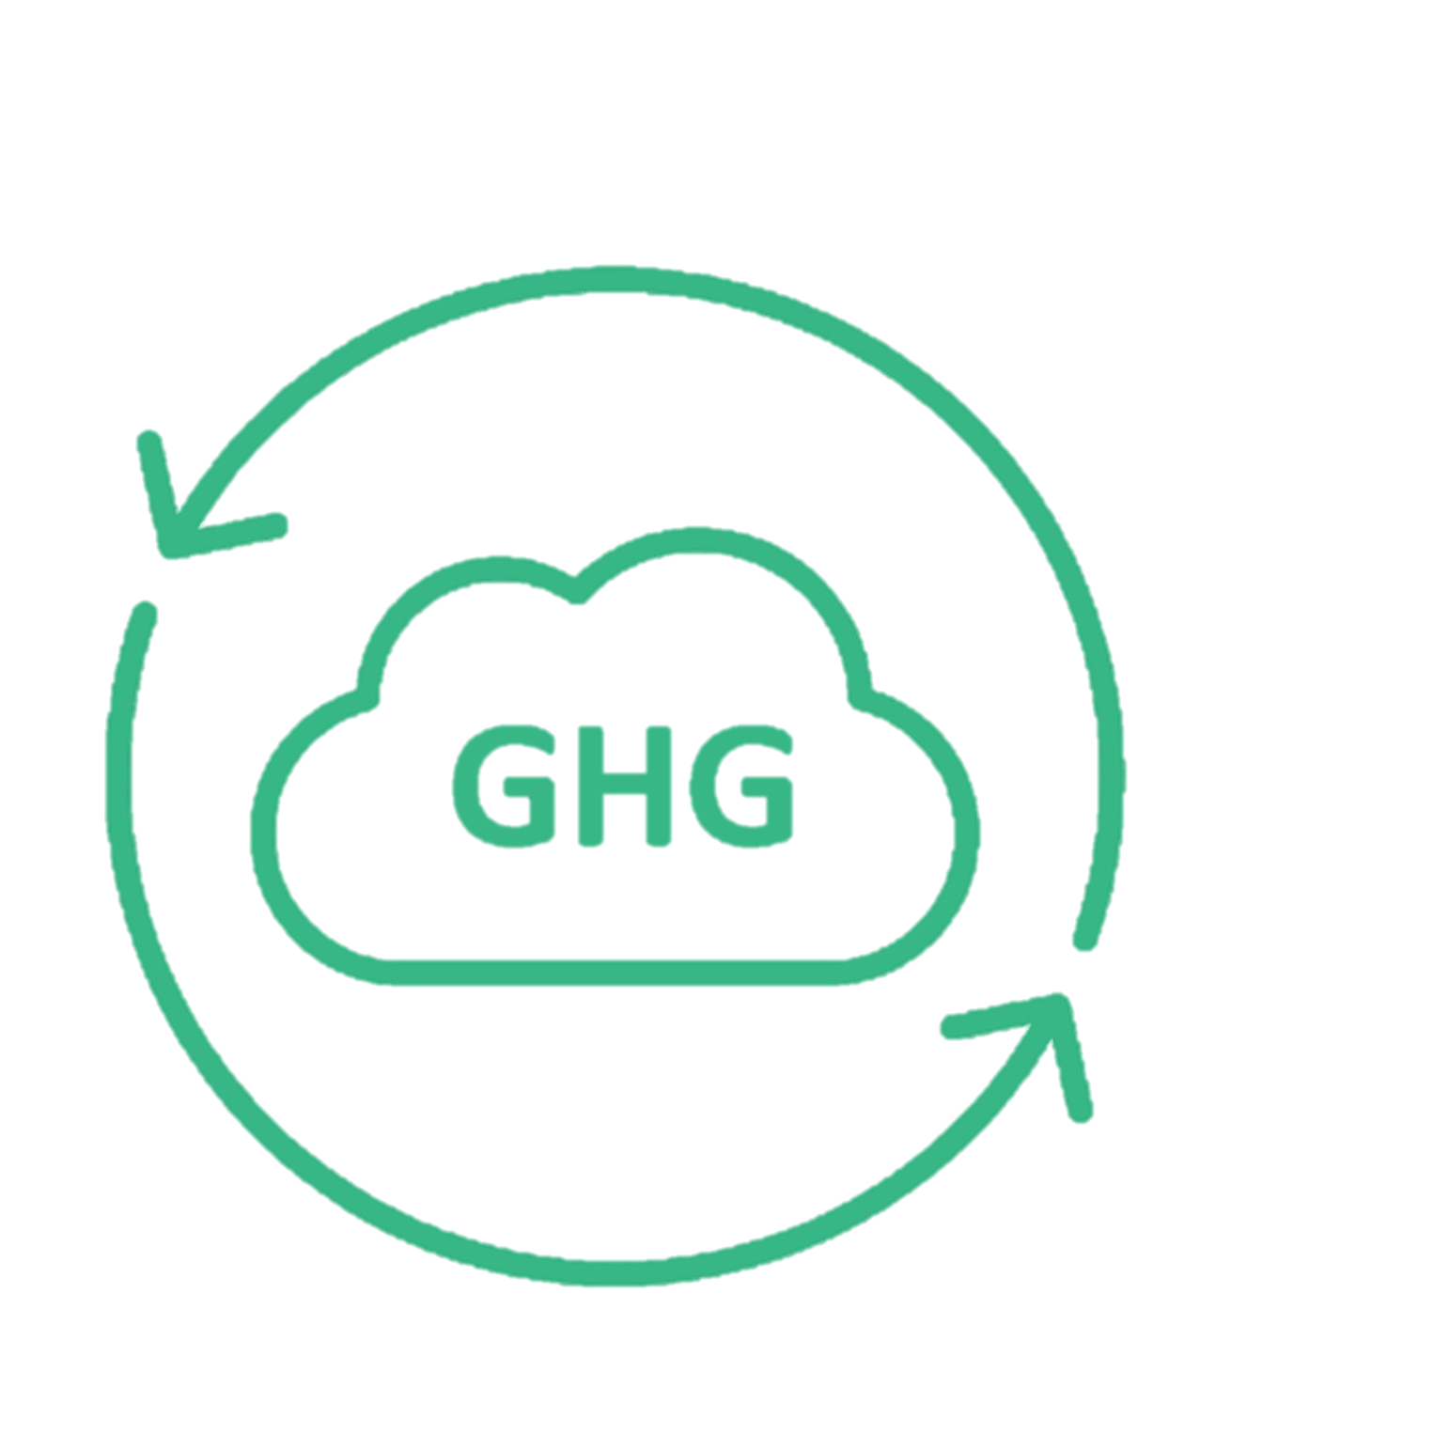
Poll the Audience Renewable Energy Training
Question:
Does your organization have a renewable energy target? Are there ambitions to set one?
Please type your answer into the chat box

Slide 22
Renewable Energy Target Setting
Target Setting
A renewable energy targets can be a component of other enterprise sustainability goals or a stand-alone target
To determine the best-fit goal structure for your organization:
Understand your organization’s energy needs
Align with other corporate goals to understand renewable energy’s contribution to goal achievement
Complete and socialize industry and peer benchmarks
Engage with finance to understand financing options
Engage with your legal team to understand risk
Notes:
Typical legal risks includes longer term contracts and risk of non delivery or price fluctuations to avoid overpaying
different markets, cost, contribution to goals (Emissions factors, needs in the area)
RE does not always reduce emissions in the same way everywhere
what are the different options? starting with unbundled because they are easy, then maybe moving to more direct contract, on-site/PPA, and then also doing this by market
This is way corning is focused on the US etc. because they have a fair amount of loads that are not tied to facilities so they are low hanging fruit. and then once your organization managed these tasks, then move onto the harder markets
PPA's can come with a lot of legal challenges, but it gets easier overtime
https://microsoft.github.io/Sustainability-Resources/renewable-energy-procurement/

Slide 23
Stakeholder Engagements
Target Setting
Stakeholders across your organization will need to be engaged when developing a renewable energy target to ensure alignment with operational objectives and growth strategies. Identifying and engaging with key stakeholders will be a primary step to assess organizational needs and ambition to set a renewable energy target.
Team | Possible Role/Interest
Executives | C-level executives drive organizational growth, management and environmental objectives. They may be a key decision maker in approving green power purchasing options.
Facilities and Energy Management Teams | May own the data and strategies related to energy needs of your organization
Procurement | Manages relationships and/or purchases from energy providers
Environmental Health and Safety | May have additional data sets and strategic considerations needed to inform decision making
Corporate Relations | This team may have insights into corporate strategies and external messaging
Marketing | May have desires to pursue product claims that can help drive the ambition of your target
Notes:
Engaging these stakeholders will ensure you are developing a meaningful target as well as mitigate any roadblocks you may encounter while seeking approval for your targets. These stakeholder engagements can also help you identify champions within the organization that will be able to support in target acheivement.
The people in an organization who are interested in green power may be high-level decision-makers (such as senior C-level executives) as well as staff from departments such as the following:  Purchasing  Facilities/energy management  Environmental health and safety  Legal  Corporate relations  Marketing A high-level green power champion is often critical to achieving green power goals, particularly because these decisions stretch across departments. This champion can help align the interests of the other key decision-makers and garner support from other important stakeholders. Knowing key decision-makers All of the interests and concerns of key decision-makers must be addressed early in the planning process. Not doing so may lead to disagreements later in the process. The list below identifies potentially influential C-level executives who may need to be involved in the decision to purchase green power.  Chief Executive Officer (CEO) – The CEO is the integrator of the organization’s growth, management and environmental objectives, and a key decision maker in approving green power purchasing options.  Chief Financial Officer (CFO) – Because buying green power is ultimately a financial decision, it is important to have the CFO involved in and supportive of the decision.  Chief Operating Officer (COO) – The COO may have overall responsibility for assessing the organization’s emissions footprint and for determining the feasibility of different green power options, including whether to purchase or self-generate.  Chief Marketing Officer (CMO) – The CMO leverages the green power activities of the organization to build the brand or the relationship with key target stakeholders.  Chief Commercial Officer (CCO) – The CCO aligns green power procurement with the organization’s commercial strategy and development.  Chief Sustainability Officer (CSO) – The CSO is often charged with driving the environmental business actions of the organization and often possesses the decision-making power to move green power decisions forward

Slide 24
Renewable Energy Target Structure Example
Target market boundary:
Boundaries can be drawn around markets and/or operational controls, and can be best fit to your own organization's strategy
Achieve XX% Renewable Energy in X regions by X year
Level of Ambition:
A 100% target is ideal, but a less ambitious target may be set to meet your organization at its current place on their sustainability journey, and the target can be expanded over time
Target Year
Target years should be set in the next 5-10 years with 2030 as the ideal target date to support Corning’s goal achievement. This time is to give your organization time to establish and carry out renewable energy procurement strategies
Notes:
100% target- does not necessarily mean this will need to be reached within each country as feasibility may vary by the regions in which you operate. Not a 24/7 target.
Market Boundary: usually in county. US and CAN are one market, most of the EU, but not all, UK is a separate market. This is relevant for organizations who operate in many markets, but can be excluded for those that have a more concentrated presence

Slide 25
Examples of Renewable Energy Targets
Target Setting
Achieve 80 percent green electricity use by 2025
Achieve 100 percent green electricity use by 2030
Supply 50 percent of electricity use from on-site generation and the remainder from green power purchases
Additional resources at the end of the presentation can help to support you in developing a renewable energy target for your organization
Notes:
First 2 are science-based targets as an alternative to absolute emissions reductions or sectoral based emissions reductions

Slide 26
Renewable Energy Procurement

Slide 27
Poll the Audience Renewable Energy Training
Question:
Has your organization procured renewable energy before?
Please type your answer into the chat box

Slide 28
Environmental Attribute Certificates
Procurement
Environmental Attribute Certificates (EAC)
An EAC is a representation of ownership rights to the environmental attributes from 1 MWh of clean energy generation. EACs use specific tracking systems in electricity markets worldwide. For example, Renewable Energy Credits (RECs) are primarily used in the U.S. and Canada, while Guarantees of Origin (GoOs or GOs) are used across European markets.
EACs solve the problem of identification, allocation, and ownership of renewable energy across a shared electric grid.
Note: Content adapted from CEBA

Slide 29
Renewable Energy Credits
Procurement
What is a REC? A renewable energy certificate (REC) is a tradable market instrument in the US that represents the generation of 1 megawatt-hour (MWh) of electricity from a renewable energy source.
RECs provide an essential accounting and tracking function in renewable energy and green power claims. There are differences depending on the state you are in, but state rules and voluntary markets generally agree that the REC instrument provides a legal basis for making green power and other environmental claims.
Market-based
GHG Emissions
Renewable Attributes
Energy Attribute Certificate (i.e. REC)
CO₂
RECs vs Electricity
Renewable Energy Generation
Electrons
Electrical Grid
End Use
Notes:
As states and organizations began developing targets for renewable electricity, a separate system of renewable energy certificates (RECs) was therefore developed to track generation delivered to the grid to meet consumer demand. RECs solve the problem of identification, allocation and ownership of renewable energy across a shared electric grid. Each REC represents 1 megawatt-hour (MWh) of electricity generated and conveys the environmental and social attributes of the generated electricity to consumers.
RECs convey information about each megawatt-hour of electricity generated and consumed: not only whether it is renewable or green but also other details such as the type of fuel or resource used to generate the electricity, air emissions created during generation, generator capacity, location and year the generator began operation, month or quarter when the electricity on which the REC is based was generated, and other characteristics associated with the generator and generation. These descriptive characteristics are usually referred to as “attributes,” and are important to documenting environmental claims and determining eligibility for programs or financial incentives. In addition to being essential to substantiate environmental claims, RECs help avoid double counting and claiming of the same generation attributes by more than one party. RECs must include all relevant information on the generation of their underlying green power including location, fuel type and month or quarter of generation. They must be tied to 1 MWh of actual green power generation no matter how large or small the f
Customers can buy green power in any quantity of megawatt-hours by purchasing RECs separately from electricity – an unbundled product option. Purchasing a standalone REC product allows organizations to effectively self-bundle the renewable energy attributes associated with the RECs with the organization’s consumed physical electricity. This is in contrast to a supplier that sells a green power product that includes both the electricity and RECs bundled together, as in the case of either a retail green power product from your electricity supplier (i.e., utility) or alternatively through the direct purchase from a specified generator. In purchasing unbundled RECs, organizations can claim receipt of the environmental attributes of the REC-generating facility (or facilities) without affecting their physical electricity purchase and delivery options. Unbundled REC purchases can be scoped to meet an organization’s electricity usage over any period of time, but monthly and annual contracts have historically been the most common transaction periods. Unbundled purchases may also be arranged as a percentage of monthly or annual electricity consumption or as a long-term fixed price contract.acility is or where the facility is located relative to the consumer.
Unbundled products provide versatility, making renewable electricity available to all grid consumers regardless of the location of the generator or consumer on the grid. Unbundled RECs also offer purchasers the flexibility to purchase renewable energy from any provider rather than being limited to a local electricity supplier. This expanded availability and ease of participation creates a larger market that supports market efficiencies, scalability and lower transaction costs, because a single REC purchase can cover a wide operational footprint through a single transaction.

Slide 30
Procurement
Renewable Energy Procurement Options
Each organization’s renewable energy roadmap will look different, and Corning is not requiring its supplier to achieve their targets with a prescribed method. Renewable energy procurement options and availability will vary by market. Risk and best-fit methods will need to be determined internally in your organizations and with your supply chain partners
Option ​ | Detail​ | Time Horizon | Impact
Owned on-site generation​ | Company builds, owns, and operates a renewable energy project on-site and maintains ownership of the generated electricity​ | Long Term | Very High
Owned off-site generation​ | Company builds, owns, and operates a renewable energy project off-site and maintains ownership of the generated electricity​ | Long Term | Very High
On-site PPA/operating lease​ | Developer builds, owns, and operates an on-site renewable energy project and sells the project generation and corresponding RECs directly to the company​ | Medium Term | High
Physical PPA​ | Developer builds, owns, and operates the renewable energy project and sells the project generation and corresponding RECs directly to the company​ | Long Term | High
Virtual PPA (vPPA)​ | The company agrees to pay a fixed price for RECs and the developer liquidates energy into the wholesale power market (floating market price). Settlement of differences between the fixed price and the floating market price can result in higher or lower costs for the buyer.​ | Long Term | Medium
Utility products / green tariffs​ | Utilities supply company with up to 100 percent renewable power from either projects that they own or independent power producers in the region​ | Near Term | Medium
Unbundled RECs​ | RECs sold independent of the underlying energy generated​ | Near Term | Low

Slide 31
Roadmap Development

Slide 32
Renewable Energy Roadmap Development
The purpose of a renewable energy roadmap is to guide your internal operational decisions to switch from its current energy mix to renewables to meet your established target.
A renewable energy roadmap should provide clear direction and strategy for leadership and energy buyers in your organization on:
Cost
Priority Markets
Acceptable Energy Types
Acceptable Deal Types
Market Engagement
External Communications
Notes:
Acceptable Energy Types: Corning’s preference for solar, repowered hydro vs small hydro, etc.
for example, work with a government on a specific deal types, working with insurance companies on policies to be clear on needs, aggregated deals. CEBA examples

Slide 33
Cost and Priority Markets
Roadmap Development
There are several factors that can affect renewable energy costs and should be considered by your organization as you develop a roadmap
Energy Type | There are varying costs associated with each of the e types you are looking to procure. These costs should be evaluated in each market.
Power Supplier | The power supplier you work with may have higher or lower costs depending on the specific service they are providing.
Quantity of Power Purchased | The volume of purchased energy can impact the cost per MWh with rates that typically get lower as the purchase volume gets larger.
Available Incentives in Local Markets | The region you are operating in may have cost saving programs to incentivize more renewable energy purchases.
Location of Energy Consumption | The market you operate will have varying options for procurement and options will need to be evaluated by market size to determine best fit options.
Notes:
The Costs There are several factors that can affect green power costs; most of them depend on the choices an organization makes. These factors include the following:  Green power product option (discussed more in Chapter 4)  Green power supplier (e.g., competitive bid or not)  Renewable resource and technology type (e.g., wind, solar, hydro, biomass)  Quantity of green power purchased  Duration and terms of contract  Available incentives for green power  Location of the generator or consumer

Slide 34
Roadmap Example (Illustrative only)
Roadmap Development

Slide 35
Overcoming obstacles
Roadmap Development
Anticipating and developing a plan to manage obstacles that may occur on your path to target achievement is a helpful element of roadmap development.
Small load in a market?
Partner with another energy user in a market
Unsure of time?
Purchase a renewable energy product that allows you to exit
Cost concerns?
Compare benefits of locking in energy prices or value of product claims

Slide 36
Key Procurement Considerations
Roadmap Development
How important is it to your organization to generate net new renewable energy?
Do you want to be able to offer products that are made with 100% renewable energy?
How long of a contract is your organization comfortable with?
Do you have preferences of specific clean or renewable technologies?*
*Corning’s preference is for projects that align with Green-e® standards which prefers solar, wind, and geothermal, but allows other options as well.
Notes:
To make claims on the products you will need to have a system to prove the claim based on where it is manufactured. Would need to be allocated in GHG Inventory.

Slide 37
Process Overview: RE Buyer’s Roadmap (adapted from CEBA)
Roadmap Development
RE Procurement Plan
develop
Market approach
run
RFP
Determine
Electricity load
Company goals
negotiate
Contract(s)
finalize
Pre-COD* details
Structure
& refine options
build
Internal support
understand
Contract options
Technology options
identify
Risk Tolerances
obtain
Final approvals
ensure
Post-COD* follow-up
Obtain
C-suite approval
build
Contracting team
*COD – Commercial Operation Date, the date the renewable energy project becomes fully operational, connected to the grid, and producing energy
Notes:
This would be for longer term contracts such as PPAs and VPPAs so you’ll want to be clear on the desired options and key elements to negotiate. For smaller deals this may be a quicker process.

Slide 38
Best Practices

Slide 39
Renewable Energy Management
Best Practices
Equity
Successful energy management plans consider and balance options such as:
Energy efficiency
Load management
Power purchases
Self-generation and non-electric (thermal) energy needs
Community and environmental impact
$
Environment
Economy
As with any investment portfolio, the best mix of these options depends on the organization’s goals, the cost of various alternatives, and external market conditions

Slide 40
Spotlight on Energy Efficiency at Corning
Best Practices
Aggressively Investing in Energy Efficiency
Corning’s Global Energy Management (GEM) program strategically manages the company’s global energy usage with consideration to energy productivity, power supply reliability, and environmental impact. GEM recently expanded its scope to include water management and a greater focus on renewable energy.
GEM’s mission is to "innovate and be responsible users of energy, water, and other natural resources. Inspired by Corning’s culture of innovation, GEM will continuously improve reliability, efficiency, and productivity in a quest to make customers and the company more competitive and to support healthier communities around the world."
GEM teams at every Corning facility around the world execute five strategies to achieve this mission:
Continuously improve energy, water, and natural resource management in operations.
Incorporate energy, water, and natural resource innovation in product development, product design, and manufacturing processes.
Engage employees and suppliers in energy, water, and natural resource management.
Ensure Corning meets customer requirements regarding energy, water, and natural resource utilization.
Analyze and communicate Corning’s progress and successes in energy, water, and natural resource innovation to internal and external stakeholders.
Due to its efforts, GEM has helped Corning achieve the ENERGY STAR® Partner of the Year award for seven consecutive years, and several Corning plants have achieved the ENERGY STAR® Challenge for Industry. Learn more about Corning's valued relationship with ENERGY STAR.
Notes:
While this doesn’t directly tie to sourcing renewable energy, energy efficiency is always the best first step as you will need to procure less energy. Reduce your energy use and replace it with renewable sources

Slide 41
Achieving an impactful corporate RE Strategy
Best Practices
Social
Stakeholder interests
Brand equity
Supporting local energy developments
Job creation
Environmental justice
Technical
Project timeline
Deal types
Performance security
Benefits to local grid
Matching 24/7 with RE
Environmental
Enterprise sustainability targets
Industry impact
Scope 2 emission reductions
Reduce negative impact of local ecosystems
Financial
Financing options
Resale of RECs
Manage electricity costs
Stakeholder alignment
Policies and incentives
Length of contract

Slide 42
Best Practices Summary
Address energy efficiency throughout your operations to minimize the need for renewable energy procurement
Corning recommends pursuing solar developments where possible
Sequence your buys to establish internal process: for example, start with unbundled RECs to get familiar with processes and costs, then consider looking at Utility options, then move onto PPA's
Work with industry professionals and consortiums to stay up to date on market trends
Renewable thermal (early stages, example of what to keep an eye out for)
Using RE investments to advance environmental justice
Matching time of energy to time of use (attributional carbon accounting/24/7)
Note: this is not something Corning is requiring or doing now, but this is an emerging industry trend
Notes:
MSFT partnership with Volt energy- developing RE to under resourced communities and then taking the RECs

Slide 43
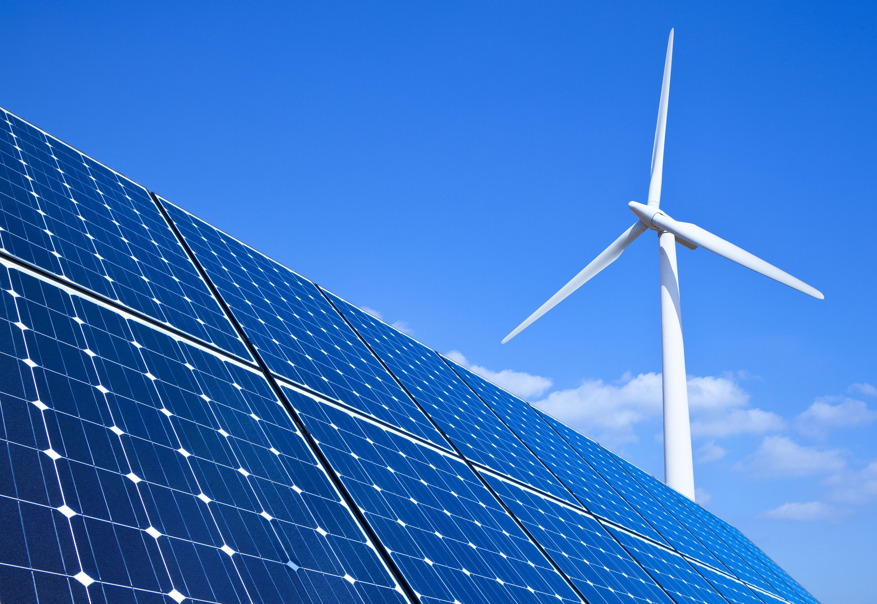
Best Practices
Resources
RE100 Climate Group
https://www.there100.org/
Renewable Energy at EPA
Clean Energy Programs
CEBA (Clean Energy Buyers Association)
https://cebuyers.org/
Green- E (helpful set of specific criteria)
Green-e® Renewable Energy Standard for Canada and the United States

Slide 44
Thank you for your continued support contact us at gsmsustainability@corning.com

Slide 45
Questions

Slide 46
Appendix

Slide 47
Roadmap Development
Renewable Energy Procurement Options
RE Procurement Opportunity | Time Horizon | Level of Effort / Risk | Financial Impacts | Environmental Benefit | Local Benefit | Electric Grid Benefit
Utility Purchasing Options
Green Tariffs | Near-term | Low | $$$
Sleeved PPAs | Long-term | Low | $
Large-Scale Direct Contract Options
Attribute Purchase Agreement | Medium-term | Medium | $$$
Virtual Power Purchase Agreements (vPPA) | Long-term | Medium | $
Physical PPAs | Long-term | High | $$
On-Site Energy Resources
Solar PV | Long-term | Medium | $$$$
Unbundled RECs
Renewable Energy Certificates (REC) | Near-term | Low | $$
47
Key: $ lowest cost lowest environmental benefit lowest local/technical benefit
$$$$ highest cost highest environmental benefit highest local/technical benefit
Notes:
Different markets, cost, contribution to goals (Emissions factors, needs in the area)
RE does not always reduce emissions in the same way everywhere
what are the different options? starting with unbundled because they are easy, then maybe moving to more direct contract, on-site/PPA, and then also doing this by market
This is way corning is focused on the US etc. because they have a fair amount of loads that are not tied to facilities so they are low hanging fruit. and then once your organization managed these tasks, then move onto the harder markets
PPA's can come with a lot of legal challenges, but it gets easier overtime

